Slide 1
Building Apps using Azure for Microsoft Teams
27-Apr-2019

Slide 2



Hi! I am Jenkins NS
SharePoint & Office 365 Solution Architect
@Cognizant
International Speaker and Blogger
jenkinsns@gmail.com
@jenkinsns
Blog : http://www.Jenkinsblogs.com
Facebook Page : https://www.facebook.com/spfxinfo/
Github : https://github.com/jenkinsns

Slide 3
1
Microsoft Teams - Overview
2
Why build apps on Microsoft Teams platform?
AGENDA
3
How are apps used within Microsoft Teams?
4
What custom apps can you valid for your organization?
5
How to build apps for Teams?
6
Build an App develop using Azure for Teams

Slide 4
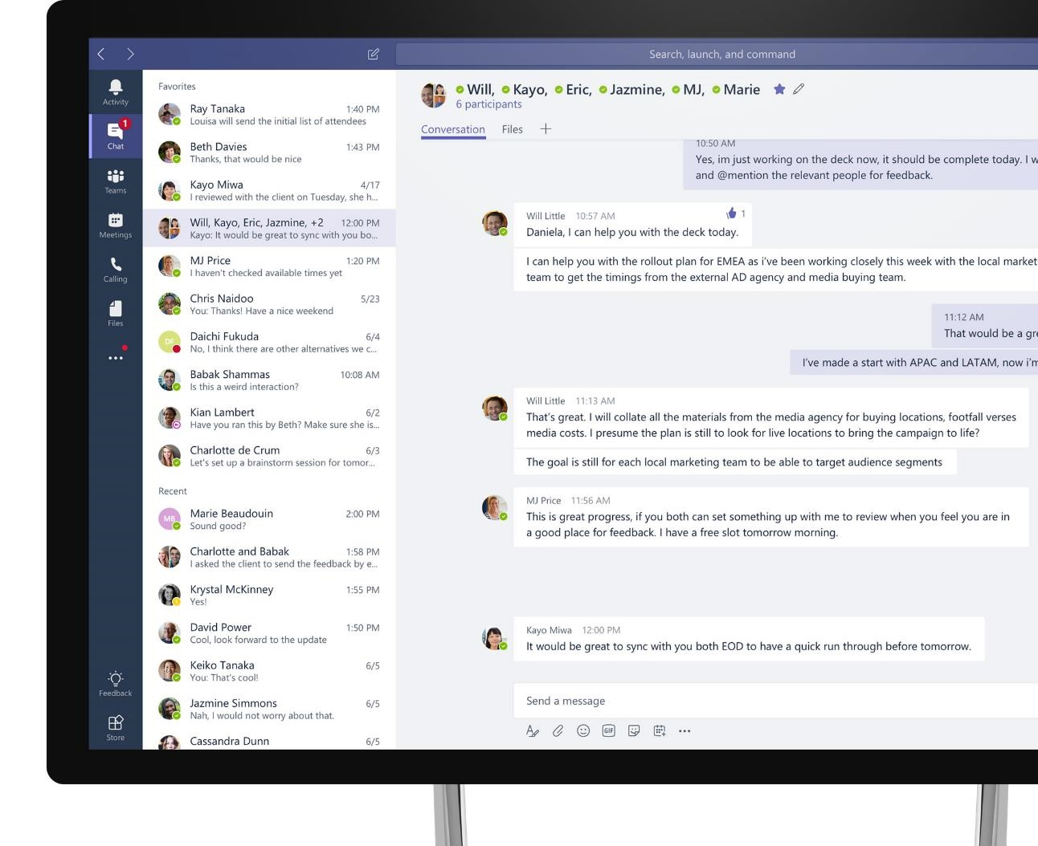
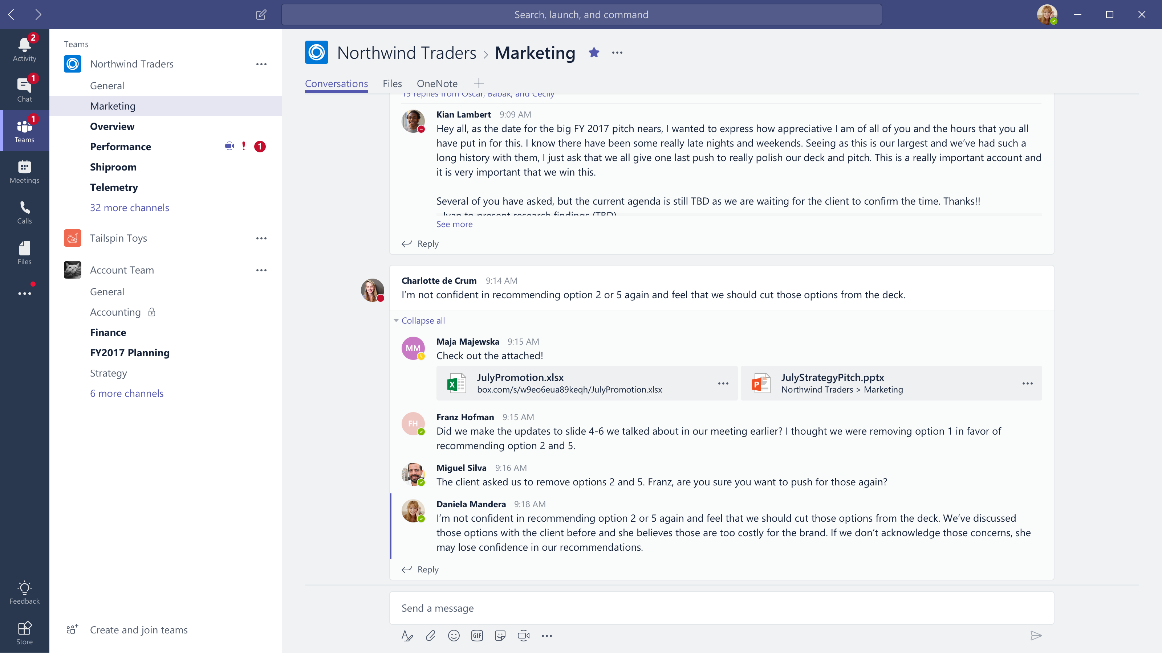


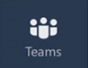
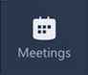




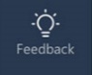

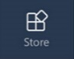
Microsoft Teams
The hub for teamwork in Office 365
Communicate
through chat, meetings & calls
Collaborate
with deeply integrated Office 365 apps
Customize & extend
with 3rd party apps, processes, and devices
Work with confidence
enterprise level security, compliance, and manageability
Notes:
[This is an animated slide. Please show it in presentation mode]
[MAIN POINT TO LAND]
Microsoft Teams is a hub for teamwork, a chat-based workspace that enables teams to be more productive by giving them a single and secure location that brings together everything a team needs: chats, meetings, calls, files, and tools. Microsoft Teams is one place for all the needs your teams have.
Microsoft Teams delivers on four core promises to create a digital workspace for high performing teams.
[COMMUNICATE]
First, Microsoft Teams solves for the communication needs of a diverse workforce.
Since preview, Microsoft Teams has evolved to include a complete meetings experience, as well as chat, voice and video -
You can use Teams for informal 1:1 or group chats – directly on your phone if you’re on the go. Or you can have an open conversation in a channel. This enables people to share information in a transparent way to accelerate decision making. And it's super easy to move from a chat into a face to face meeting, helping you to bridge geographical barriers.
[COLLABORATE]
When it comes to collaboration, the deep Office integration enables today’s multigenerational workforce to use the Office apps they are familiar with and love - Word, Excel, PowerPoint, OneNote, SharePoint, Planner, even Power BI - right within the context of Teams. Teams is unique in how we enable collaboration.
Today, when you want somebody’s feedback, you send them the file via email, they store it locally with comments, you store it again…… it's a vicious cycle that results in v2, v3, v4 versions – and you have to jump between email and other apps to get the work done. Teams brings all the Office 365 services together – so that you can easily share and co-author files without the need for email attachments.
[CUSTOMIZE]
Many of you use other services than Office 365 as well which results in you having to jump between and spend time in disparate experiences. We built Teams to not only be the hub for Office 365 services, but for all the services and tools teams use on a day to day basis. So, you can customize Teams with tabs, connector and bots to include the apps and services you need - <mention relevant 3rd party apps like GitHub and Trello that can be included in Teams>– we have integrations with over 150 partners. For our developer community, we have also created an extensible platform, to enable building apps and to integrate with business processes.
[WORK WITH CONFIDENCE]
Microsoft Teams comes with the enterprise grade security, compliance and manageability that you expect from Office 365 which customers tell us is a huge value add for them.

Slide 5
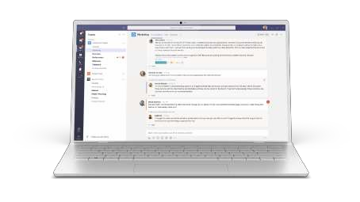
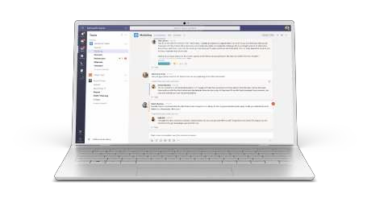
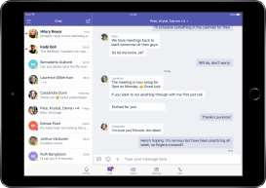


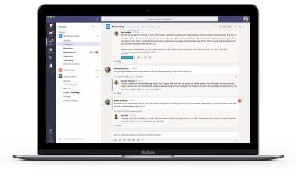
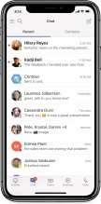




Cross platform presence – Teams where you want it
Desktop
Mobile
Browsers
Windows 7+
iPad
Edge
Chrome
Firefox
OS X 10.10+
iPhone
Android

Slide 6






STANDALONE WEB, DEVICE, AND SERVICE APPS
Conversation are Core to the Office 365 Platform
EXTENSIONS


EMBEDDED CANVASES
Microsoft Graph
External Data & Content

Slide 7




Enable your teams to make decisions and
take action faster
Make teamwork more productive with Teams Apps
HUB EXPERIENCE
Reduce context switching on important tasks
Create opportunities for collaboration around external content
1st Party Apps
3rd Party Apps
Custom Apps

Slide 8





Why build apps on Microsoft Teams platform?
Effortless discovery
Each employee already has access to Microsoft Teams as the primary collaboration and communication platform. It’s intuitive to leverage an existing platform to float your app / service. Bring your service to where your users already are
Choose the audience for your app
Drive engagement by submitting your app to the Office Store for entire world to us or submit only to your organization’s
Company App Catalog to distribute only to employees
Conversations come free!
Microsoft Teams is built for collaboration through conversations which means your app / service does not need to build a conversation layer of its own – just plug into ours
Rich App Platform
Microsoft Teams app platform supports 7 capabilities already and more are coming up every quarter so that you can build immersive experiences on an enterprise-grade app platform!
Build once, use everywhere
Reduce design, development and service overheads by building a Microsoft Teams app once and enable users to access it across Microsoft Teams clients on Windows Desktop, Mac, Web, Android and iOS platform

Slide 9
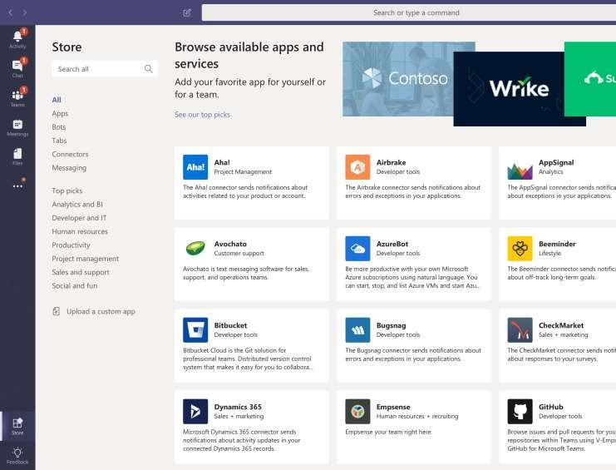
Microsoft Teams Platform
Extensible and customizable so that you can reach your users in their chats, channels, and personal workspace. A single app can provide one or more capabilities
Bots
Help users get tasks done in conversations
Tabs
Surface rich content within Teams
Connectors
Post rich updates to channels
Actionable Messaging
Add rich interactions to your connector cards
Compose Extensions
Query and share rich cards in conversations
Activity Feed
Engage user via notifications.
SPFX – SharePoint Framework Webpart

Slide 10
How are apps used within Microsoft Teams?
Walkthrough
Demo

Slide 11



Build Apps in Teams
Two kinds of app experiences
Your app can provide content and services in channels, which enable groups of people to work collaboratively, or in personal or group chats or both. The term we use for services in channels is team scope and for chats is personal scope.
Team Apps
Personal Apps
Installed into Teams & Channels
Accessible by all team members
Installed into your left rail
Accessible only by you
Therefore, always think SCOPES!

Slide 12











Departmental tools
What custom apps can you valid for your organization
Modernize your business scenarios
Employee resources
Optimize teamwork by integrating existing workflows and processes
Introduce new experiences directly for the Teams hub and take advantage of its rich canvas
Support & info
Processes & workflow

Slide 13












Recommendations
Leverage existing SharePoint portals or Websites by bringing them in as tabs
Notify users 1:1 or in channels through bot notifications in the Activity Feed
Choose one or more platform capabilities from Microsoft offerings to suit your app scenarios
Build immersive apps by implementing multiple platform capabilities in your app
Implement bots to leverage conversations for quick workflows and queries
Leverage new adaptive cards to surface rich, actionable UI across all clients
Build intelligent apps using Office 365 knowledge available through Graph APIs
Navigate the user flow from one app capability to another using deep links
Adopt a refined way of querying content & sharing information from your services
Bake in-the- moment actions right inside your app to reduce context switching

Slide 14
How to build apps for Teams
1
2
3
4
5
Polish the
experience
Get Started
Enhance conversations
Test your app
Distribute and automate
Connect your content
Add AI and context
Build for shareability
Iterate and Improve
Make it available
Publish to your
company catalog
Or, submit to the Office Store
Improve the experience basis end user feedback and analytics data
Publish to your
company catalog
Or, submit to the Office Store
Improve the experience basis end user feedback and analytics data
Reuse your existing
web app in a Tab
Aggregate with personal apps
Create the app manifest using Teams App Studio
Enable conversations via Azure Bot Service
Plug in Graph APIs
Add Adaptive Cards
Leverage compose extensions to query content from your app & drop into conversations
Build UX optimized for Teams

Slide 15
Build an App develop using Azure for Teams
Demo
Demo

Slide 16
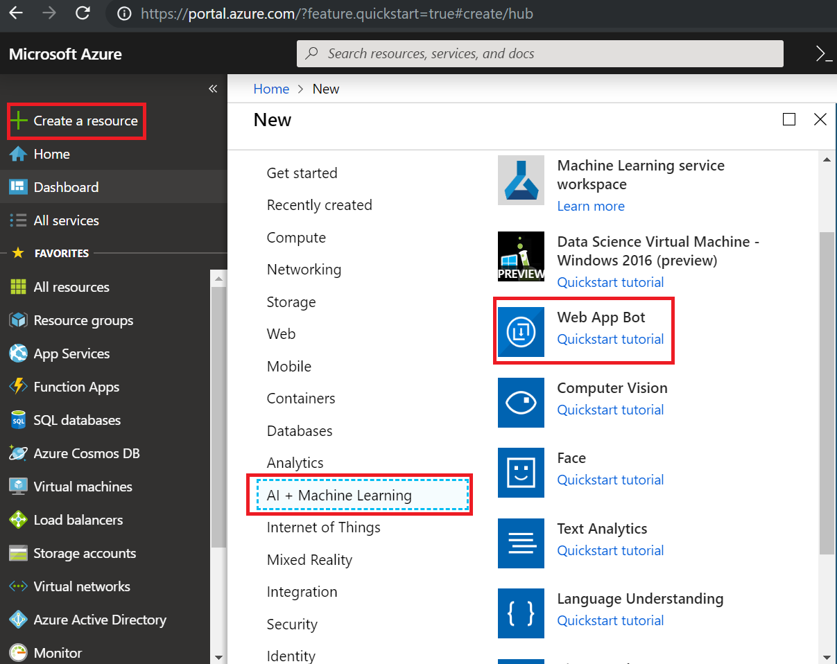
Create a Web App Bot – Azure Bot Service
Login to Azure portal– https://portal.azure.com
Click Create new resource link found on the upper left-hand corner of the Azure portal.
then select AI + Machine Learning > Web App bot
It will open a new window

Slide 17
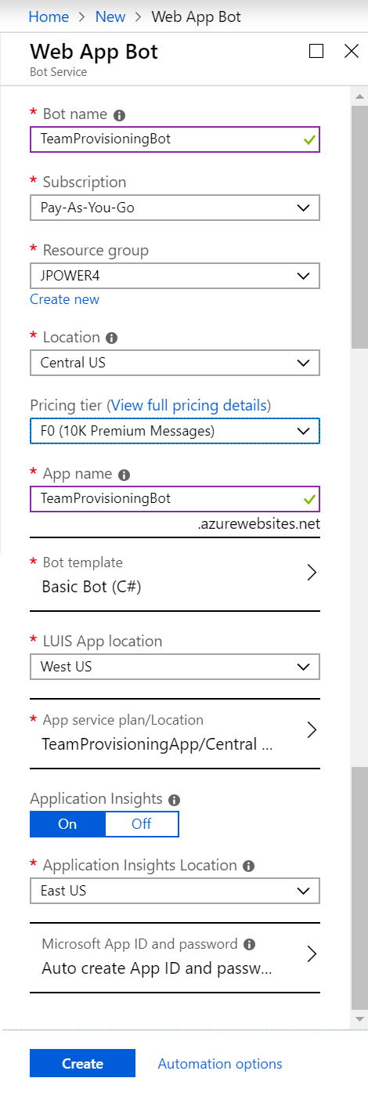
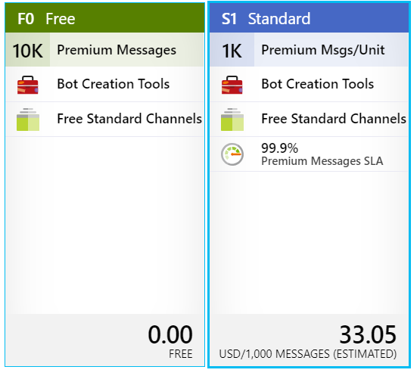
… continue
Fill the form
Bot Name
Subscription
Resource group (create a new resource group or use existing one
Select your location based on your customer
Pricing tier
F0 (10K Premium Messages) – Free
S1 (1K Premium Msgs/Unit) - $33.05
App name
Select Bot Template
LUIS App Location
App Service plan/location
Application Insights
Application Insights location
Microsoft App ID and password

Slide 18
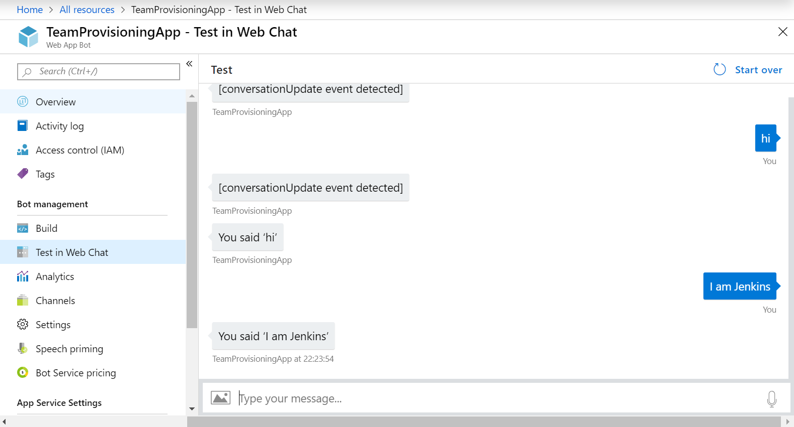
Test the Bot

Slide 19
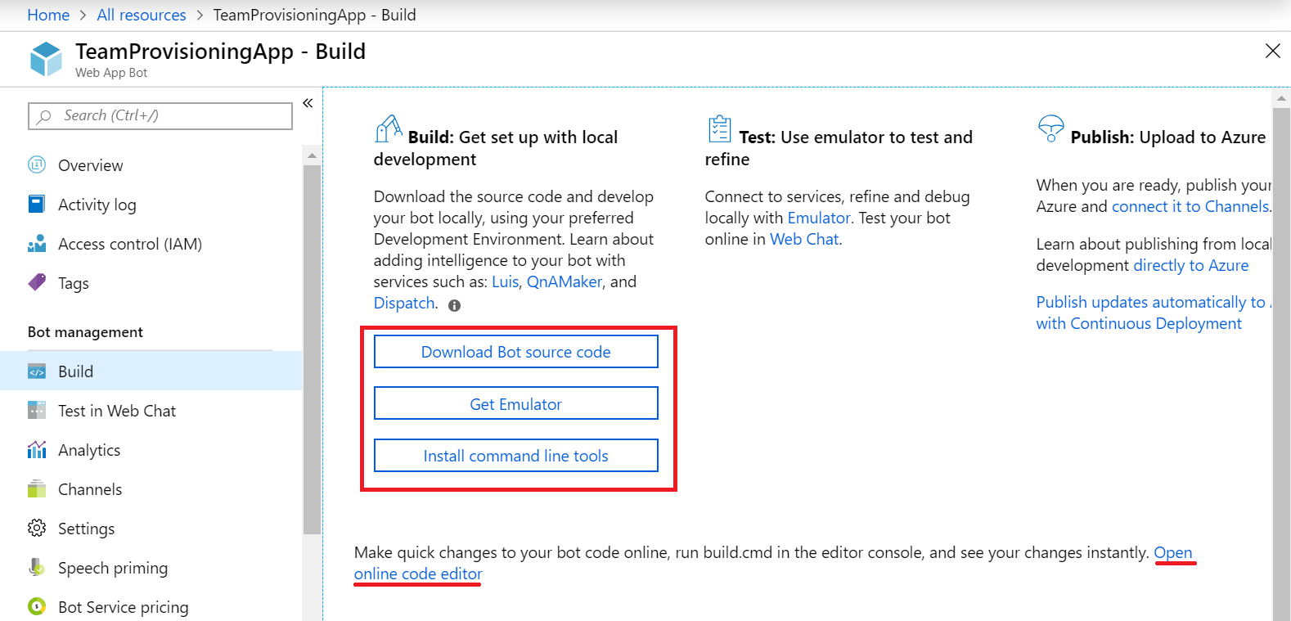
Build the Bot in our local environment
Download code - You can download the code to work on it locally.
In the Bot Management section, click Build.
Click on Download Bot source code link in the right-pane.
Follow the prompts to download the code, and then unzip the folder.
When downloading your bot, you will be given the option to include the settings (containing the keys and secrets) for your bot in your download, which may be necessary for your bot to work.
If you choose Yes, the appsettings.json or .env file will have the keys

Slide 20
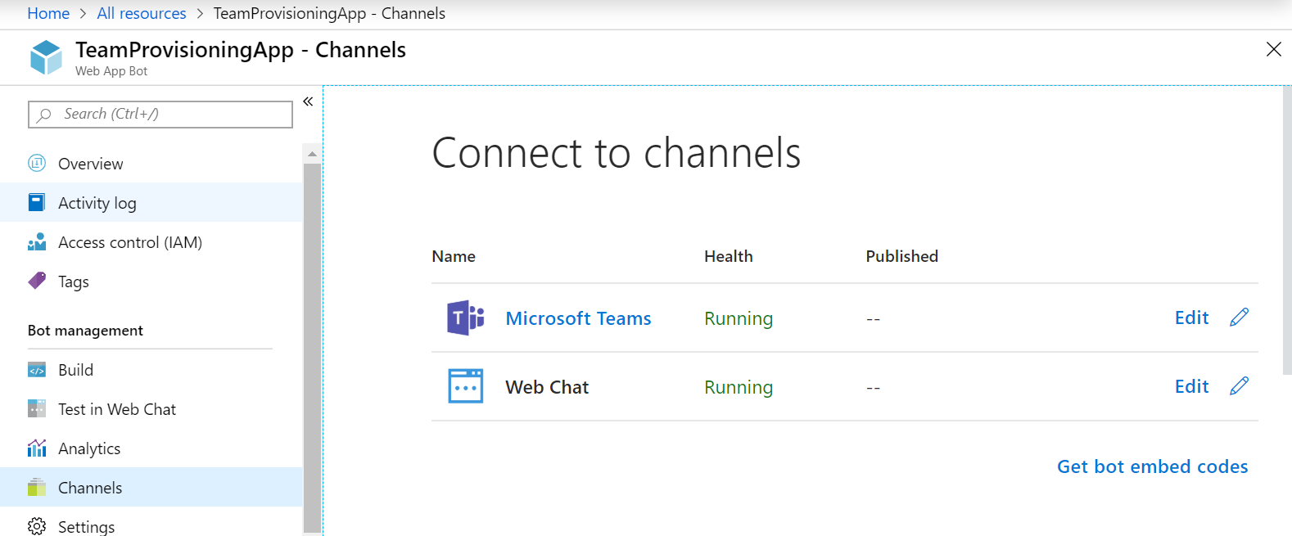
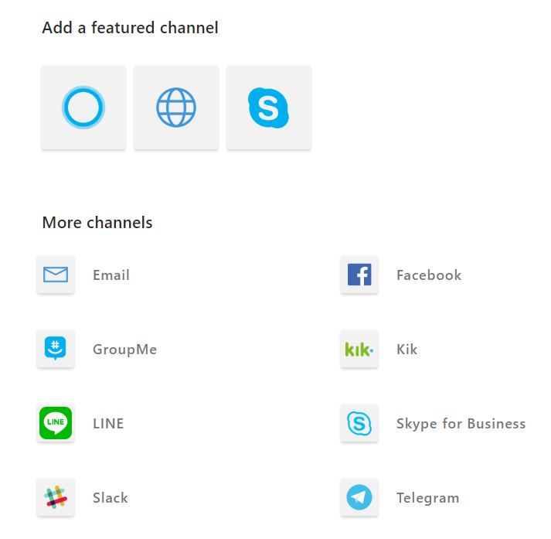
Publishing Channels

Slide 21
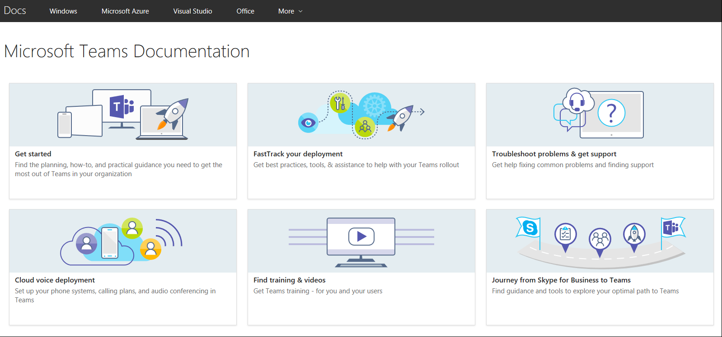
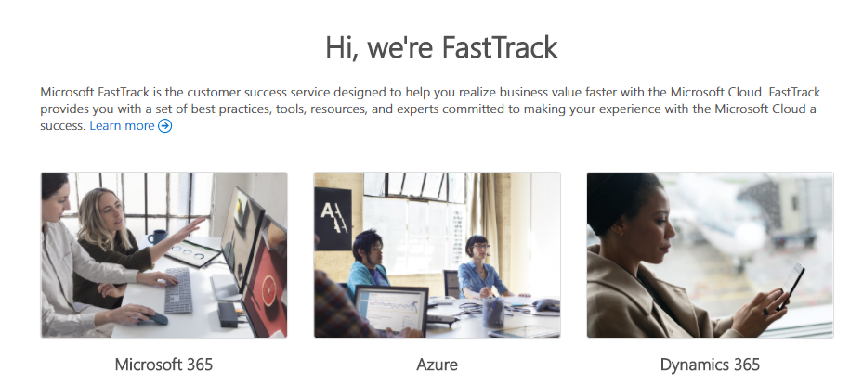
Resources to Learn
https://aka.ms/SuccessWithTeams
https://FastTrack.microsoft.comwith
Resource | Link
Office Blog | https://aka.ms/OfficeBlog
Office Roadmap | https://aka.ms/OfficeRoadmap
Product Help Known Issues List | https://aka.ms/TeamsSupport https://aka.ms/TeamsKnownIssues
Team Developer Hub | https://TeamsDeveloper

Slide 22
@gabchennai

